Slide 1
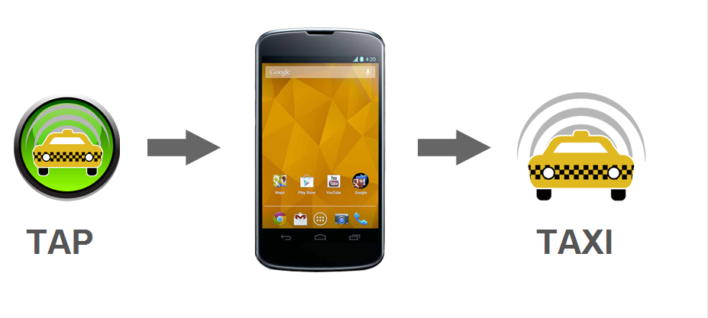
Any cab

Slide 2
Agenda
To develop an android app that can connects you directly to taxi drivers through the agency in the TAP of a button
AnyCab introduces a completely unique driver’s application, where drivers can receive push notifications of the passenger’s location.
AnyCab is a great online / mobile platform for both taxi drivers and passengers.

Slide 3
Technologies used.
Android
Google Map Api v2
Google Location Api
Fused location Provider
Parse Cloud datastore
Languages used.
Java
JSP

Slide 4
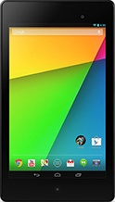



what is android?
Android is an open source Linux-based operating system designed for touch screen mobile devices such as smart phones, tablets and even watches and TVs.

Slide 5
why we choose android?
Users rapidly migrating from website to mobile phone
Android is free, open source and the most popular
Google products work best on android
Powerful, simple and beautiful
Fast application development in Java
Over 1.5 million android devices every day
More than 70 % of mobile developers are android developers

Slide 6
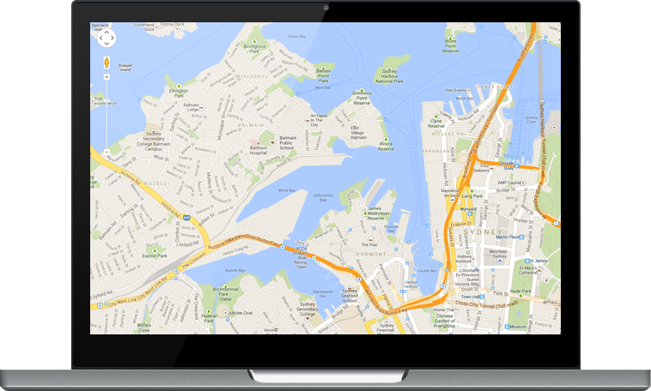
Google Map Api v2
Creating a map is nearly impossible. It helps us to use the real google map in our application.

Slide 7
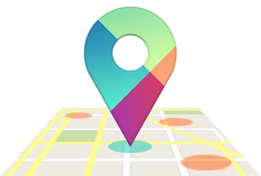
Google location Api
The location APIs make it easy for you to build location-aware applications, without needing to focus on the details of the underlying location technology. They also let you minimize power consumption by using all of the capabilities of the device hardware. Also helps to find latitude and longitude from a location name.

Slide 8
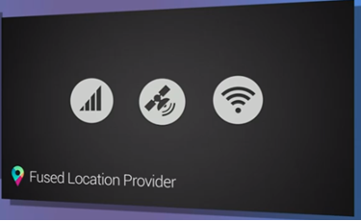

Slide 9
Location is critical to a new generation of contextual apps that are more aware of where the user is and what they're doing.
In mobile phone technology, we can sense the current location only by using the following providers.
1. GPS (global positioning system)
2. Wi-Fi
3. Network provider (idea, airtel, bsnl etc)

Slide 10
Many of the apps available in google play store uses any one of these services for tracking users current position. But each of the services has its own pros and cons.
GPS feasts on your Smartphone's battery (though not as much as the display does). Many users turn GPS off on their phones to extend battery life, and even apps use it cautiously.
However, GPS (or location) is also a key component of what many of the interesting apps and services rely on.

Slide 11
Wi-Fi has less location accuracy when compare to gps but less power consumption also.
Network providers are very weak in delivering the accurate location updates, but the least power consumption.
To handle the battery life problem, Google announced a fused location API. In principle, this would be a single API that would let users access location services. Behind the scenes, the API combines GPS, Wi-Fi, cellular data and other sensors to detect the user’s location.

Slide 12
Parse clod data store
Android has a built in database called SqLite.
But what happens if the mobile phone is lost or the application database is accidently got deleted forever ?
ans : Cloud datastore .
Now a days many third party vendors provide cloud data storage options for android, ios and windows mobile.
Some of them are google app engine, windows azure, amazon cloud, facebook parse etc.

Slide 13
So parse is a cloud database in which data is stored and retrieved in the form of non sql entities.
Parse focusing on creating a great user experience and forget complex infrastructure. Instantly add a powerful core, push notifications, and analytics to your app with Parse.

Slide 14
Sample json
{
"Title": "The Cuckoo's Calling",
"Author": "Robert Galbraith",
"Genre": "classic crime novel",
"Detail": {
"Publisher": "Little Brown",
"Publication_Year": 2013,
"ISBN-13": 9781408704004,
"Language": "English",
"Pages": 494
},
"Price": [
{
"type": "Hardcover",
"price": 16.65
},
{
"type": "Kidle Edition",
"price": 7.03
}
]
}

Slide 15
Modules
-> Central Agency Creation
-> Cab Registration
-> Cab Location
-> User Location Tracking

Slide 16
Project Logic
Step 1
Create an Android app with a cloud data base on Parse.
The cabs register the device with a unique username and password provided by admin

Slide 17
Step 2
Implement the cab tracking module by finding the current location with the help of fusion location provider.
Create a cloud account on Parse and create the registration, tracking tables.
User get the details of the cabbie of his current location. User can select the available cabbie and send a request.
Find the geographic position (latitude and longitude) of the user using fusion location provider and send the location, co-ordinates, cabbie details to the cloud database from a background service.

Slide 18
Step 3
Create a web application by using JSP, with an admin login system to monitor all the activities, user’s current location etc.
All the datas can be collected back from the cloud database that we prepared.

